Slide 1


Update on MFS in Africa today
Claire Scharwatt,
Senior Market Engagement Manager, MENA & West Africa – GSMA Mobile Money
3rd Annual Leaders’ Roundtable of the AMPI - 23 July 2015

Slide 2
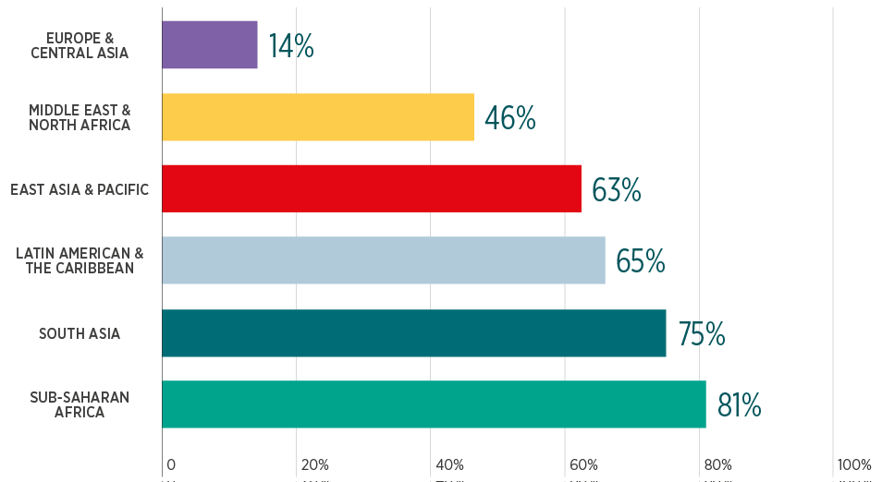
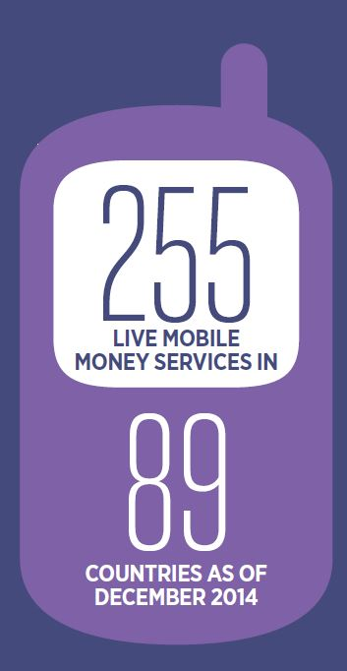
Mobile money is now available in >80% of countries in Sub-Saharan Africa
% of developing markets with mobile money per region (Dec. 2014)
2 new launches in SSA this year so far
Source: GSMA Mobile Money Intelligence

Slide 3
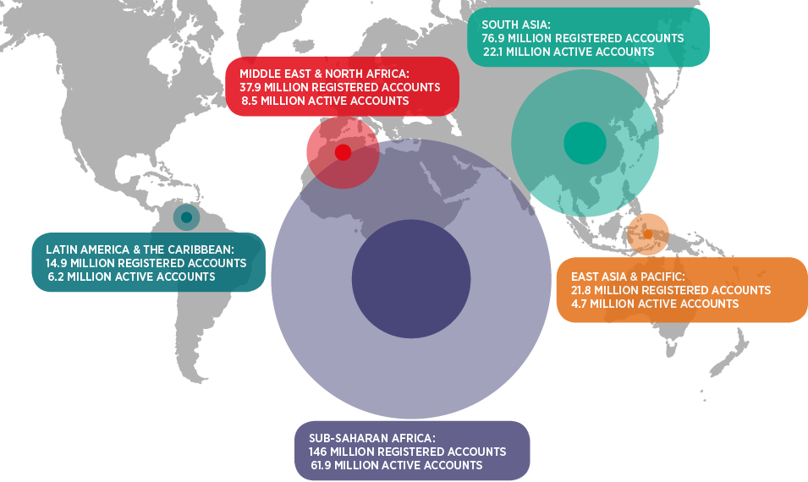
With 62m active accounts, SSA is the region where we find most of mobile money active users
Source: GSMA Mobile Money Intelligence

Slide 4
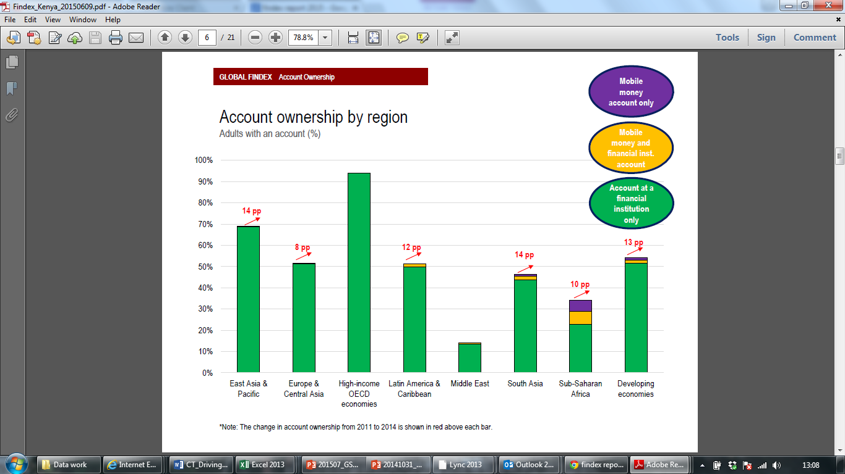
Mobile money has become a major enabler of financial inclusion
% of adults with an account
Mobile money account only Financial institution account
Mobile money and financial institution account
Source: Findex
Notes:
Introduce session on last mile

Slide 5
In December 2014, we recorded 482.5m mobile money transactions worth USD 10.7bn in SSA
Middle Africa: 235m (+92%)
Southern Africa: 402m (+40%)
Western Africa: 1.4bn (+71%)
Eastern Africa: 8.6bn (+19%)
Deep penetration in East Africa and fast growth in West Africa
Source: GSMA Mobile Money Intelligence
Notes:
Cdi and ghana

Slide 6
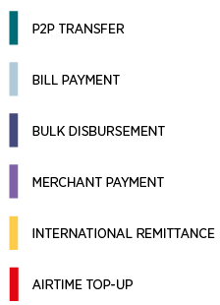
A product mix still largely dominated by domestic P2P transfers although less than in previous years
Global product mix* by volume & by value (Dec. 2014)
Merchant payments and international remittance were the fastest growing products in 2014.
* Excluding cash-in and cash-out
Source: GSMA Mobile Money Intelligence

Slide 7
Spotlight on mobile money cross-border transfers: West Africa is leading the way
38% of international transfers via mobile money happen in West Africa
Mobile money intra-regional transfers are driving the growth
Key use cases include migrant workers sending money back home and cross-border trade
Benefits for users: affordability (~2.5% fee), convenience, transparency

Slide 8
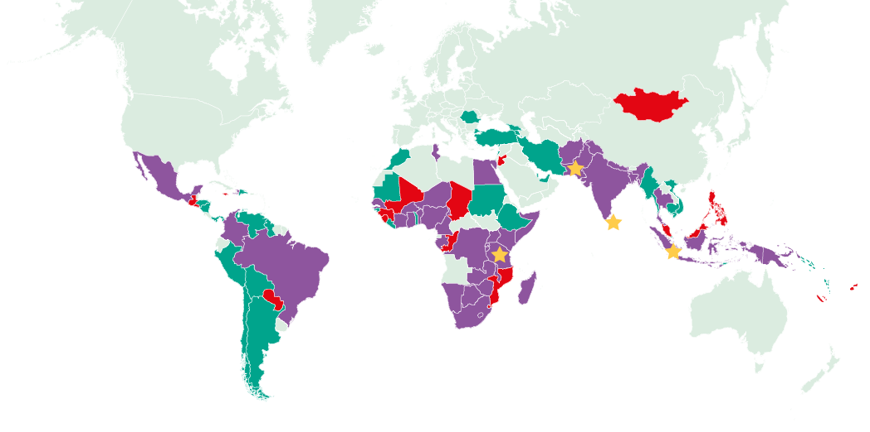




Tanzania was the first country where mobile money services became interoperable in SSA
MNOs in XX other countries are working together to interconnect their services
Notes:
Mada rwanda

Slide 9
Enabling future growth of mobile money
Policy evolution
Policy makers can take stock of their existing polices and review them as the market evolves to enable sustainable growth of MM services
Ex: Ghana, Liberia
Inter-operability
Policymakers shall enable market-led solutions, ensuring that interoperability brings value to the customer, makes commercial sense, is set up at the right time.
Ex: Tanzania
International remittances
The risks associated with cross-border remittances can be effectively mitigated; cross-border remittances can contribute to a digital MFS ecosystem
Ex: BCEAO
P2G & G2P
Policy makers and regulators should encourage the digitization of P2G and G2P payments via mobile money
Ex: Côte d’Ivoire, Kenya

Slide 10
12 telco groups have endorsed GSMA Mobile Money Code of Conduct
By endorsing the Code, providers commit to:
Safeguard customer funds against risk of loss;
Maintain effective mechanisms to combat ML/FT;
Equip and monitor staff, agents, and entities providing outsourced services to ensure that they offer safe and reliable services;
Ensure reliable service provision with sufficient network and system capacity;
Take robust steps to ensure the security of the mobile network and channel;
Communicate clear, sufficient and timely information to empower customers to make informed decisions;
Develop mechanisms to ensure that complaints are effectively addressed and problems are resolved in a timely manner; and
Collect, process, and/or transmit personal data fairly and securely.

